Slide 1



Build RAG with Gemini & LangChain
Sean Wong
2025/08/05

Slide 2
01.
02.
Kick-off & Architecture
Environment & Data Ingest
03.
04.
Contents
Chunking & Embeddings
Vector Store & Retrieval
05.
Wrap-up & Next Steps

Slide 3



Kick-off & Architecture
01

Slide 4

Course Goals & 3-Day Roadmap
AI Knowledge Assistant Features
We will build an AI Knowledge Assistant with document uploads, chunking pipeline, Gemini embeddings, Chroma vector store, RAG + tools + agents, and a deployable web UI.
3-Day Schedule
Day 1 focuses on foundations and vector DB. Day 2 covers RAG, tools, and agents. Day 3 is dedicated to UI development and deployment.
Daily Milestones
Each day has clear milestones to ensure steady progress. By the end of Day 1, you will have the foundation for your RAG assistant.

Slide 5

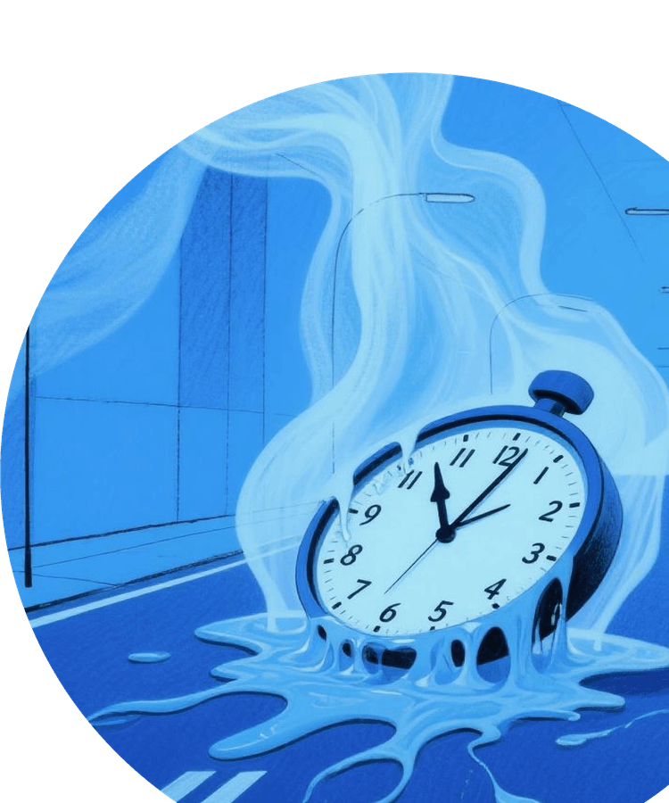
Gemini + LangChain Stack Explained
Gemini Capabilities
Gemini is a multimodal LLM that provides chat, embeddings, structured output, and function calling. It serves as the core generation engine.
LangChain Features
LangChain offers tooling frameworks, chains, agents, retrieval pipelines, and vector store integrations to orchestrate the RAG workflow.

Slide 6

Minimal & Detailed RAG Flow
Minimal Pipeline
Documents are loaded, chunked, embedded, stored in a vector DB, retrieved, and fed to Gemini to generate answers.
Detailed Flow
User queries trigger the retriever to fetch relevant chunks, which are combined with the query and sent to Gemini for a final answer with citations.
Component Roles
Each component—loader, chunker, embeddings, vector DB, retriever, and LLM—plays a specific role in the RAG architecture.
Integration Benefits
The integration of Gemini and LangChain streamlines the RAG process, making it efficient and scalable for various applications.

Slide 7
Environment & Data Ingest
02

Slide 8



Dev Setup & Secure API Key Flow
Setup Steps
Install dependencies, create a .env file with GEMINI_API_KEY, test the API connection, and verify the documents folder exists to ensure a secure and functional environment.

Slide 9
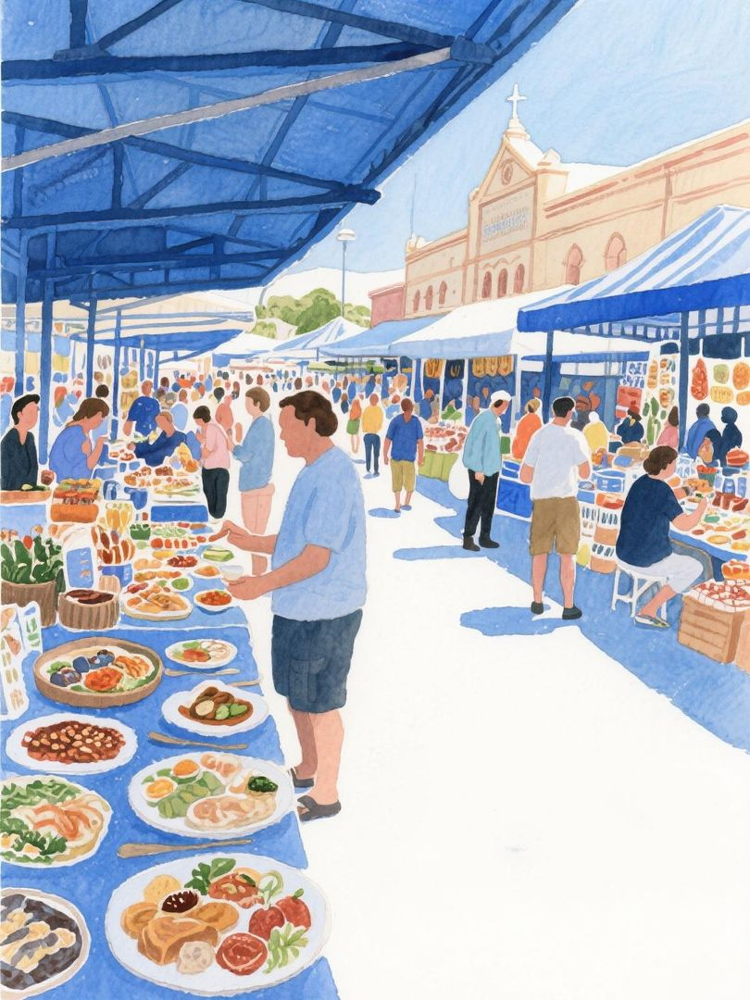
Load Multiple Document Formats
Loader Options
Use PyPDFLoader for PDFs, TextLoader for text files, and UnstructuredLoader for mixed office documents to handle diverse data formats.
Unified Document Objects
The load_docs() function returns a unified list of LangChain Document objects, simplifying downstream processing regardless of the source format.
Extensibility
This approach ensures that the system can easily adapt to new document types and formats as needed.

Slide 10
Chunking & Embeddings
03

Slide 11



Chunking Motivation
Hyperparameters
Chunking is essential to fit context windows, avoid token overflow, and improve retrieval specificity for LLMs.
Start with chunk_size 700 tokens and chunk_overlap 150 tokens to balance granularity and semantic preservation.
Chunking Strategy & Overlap Trade-offs

Slide 12

Recursive Splitting in Action
Splitting Code
Use RecursiveCharacterTextSplitter with specified chunk size and overlap to split documents into manageable chunks.
Recursive Approach
The recursive method tries sentence boundaries first, then whitespace, preserving context better than fixed-length cuts.
Metadata Preservation
Chunks retain metadata like page numbers, which is crucial for later citation and traceability.
Practical Benefits
This approach ensures that chunks are semantically coherent and ready for embedding and retrieval.

Slide 13


Gemini Embeddings Model Deep Dive
Embeddings Model
Use models/embedding-001 for 768-dimensional embeddings with high throughput and native multimodal support.
Embedding Code
Instantiate GoogleGenerativeAIEmbeddings and use embed_query() to convert text into semantic vectors.
Semantic Representation
Embeddings capture the semantic meaning of text, enabling similarity search in the vector database.

Slide 14
Vector Store & Retrieval
04

Slide 15

Why Chroma for Prototyping
Chroma Attributes
Chroma is chosen for its pure-Python implementation, local persistence, memory efficiency, and seamless LangChain integration, making it ideal for rapid prototyping.

Slide 16


Persist Chroma Collection Code
Persistence Code
Use Chroma.from_documents() to persist the collection to ./chroma_db, ensuring data durability across sessions.
Automatic Index Creation
Scalability
Chroma automatically creates indexes, eliminating the need for manual configuration in typical prototypes.
While Chroma is perfect for initial prototypes, it can scale to client-server mode for larger deployments.

Slide 17


Verify Retrieval Quality
Retrieval Test
Load the persisted store and use similarity_search() to retrieve relevant chunks based on a sample query.
Validation
Successful retrieval of meaningful chunks validates the chunking and embedding process, ensuring the system is ready for RAG chaining.

Slide 18
Wrap-up & Next Steps
05

Slide 19



Day 1 Milestone Checklist
Importance of Milestones
Achievements
These milestones form the retrieval backbone of the RAG system, ensuring steady progress towards the final AI Knowledge Assistant.
By the end of Day 1, you should have loaded documents, chunked them, generated Gemini embeddings, created a persistent vector DB, and successfully queried it.
Commit and Backup
Next Steps
Commit your code to GitHub and backup the chroma_db folder to ensure a solid foundation for Day 2.
Prepare for Day 2 by reviewing the agenda and ensuring your environment is ready for RAG chaining and tool integration.

Slide 20



Lab Instructions & Tomorrow Peek
Lab Instructions
Follow the lab instructions to rerun notebook cells, swap your own PDFs, tweak chunk sizes, and re-measure retrieval relevance. Troubleshoot common errors and prepare for Day 2’s agenda on RAG, tools, agents, and optional vision features.

Slide 21

Thank You
Sean Wong
2025/08/05

